Slide 1

CMPT 2400 - DATA PREPAERATION ANALYTICS
Forecasting Pollution Reduction in Canadian Provinces Using NPRI Data in next five years.
-ML Champs

Slide 2

Team Members
Instructor - Nasimeh Asgarian
Inderjeet Singh (Team Leader)
Aditya Mehta (Scrum master)
Ishmeet Singh
Farhan Mohammad

Slide 3

Environment Climate Change Canada
Environment and Climate Change Canada (ECCC) is the federal government department responsible for environmental policies, regulations, and conservation efforts in Canada. It focuses on protecting the environment, conserving natural resources, and addressing climate change.

Slide 4
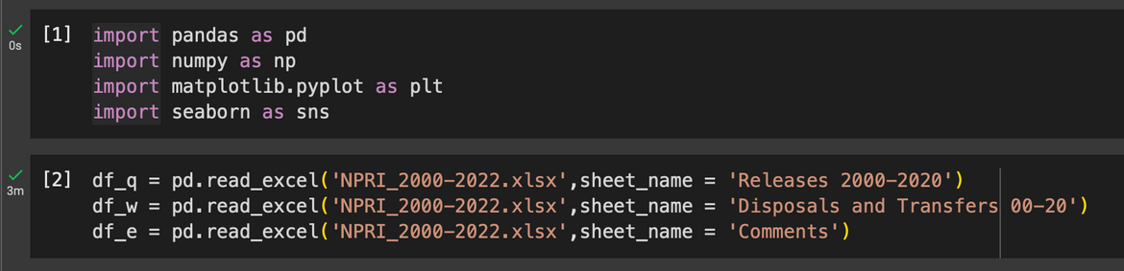
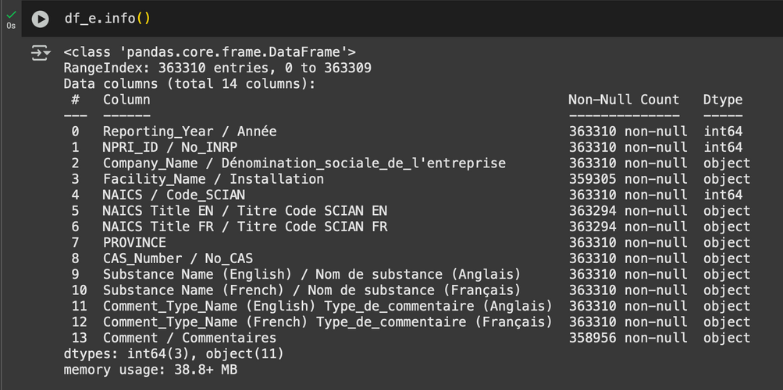
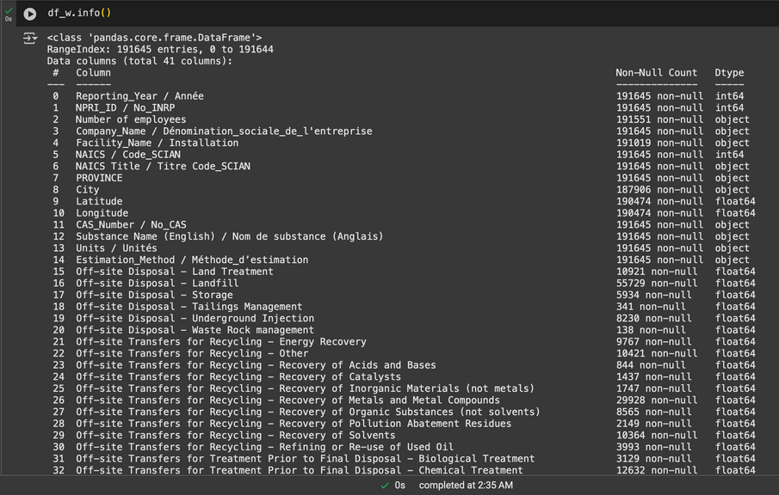
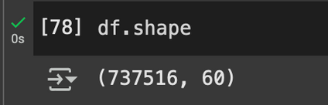
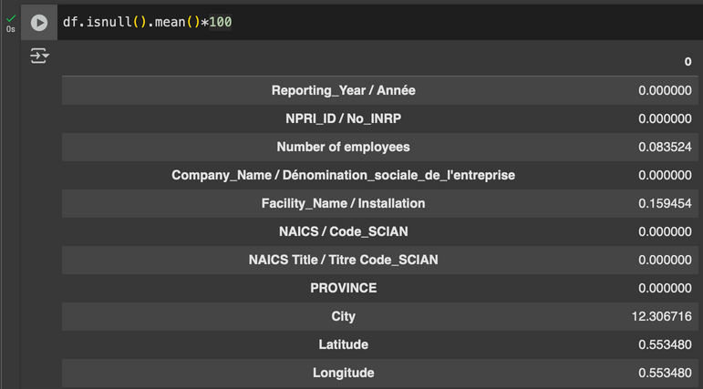
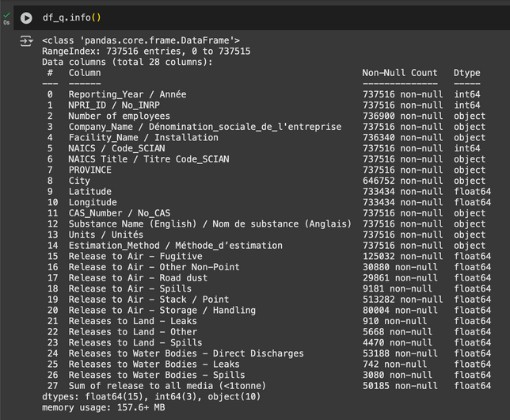
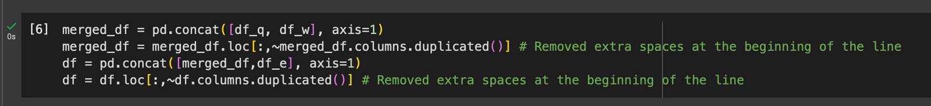
Basic EDA (Exploratory Data Analysis)

Slide 5
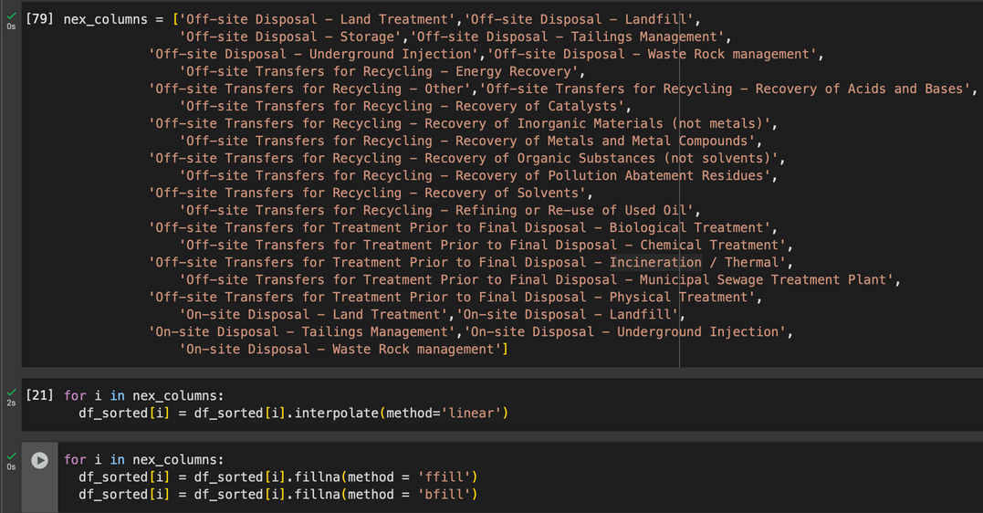
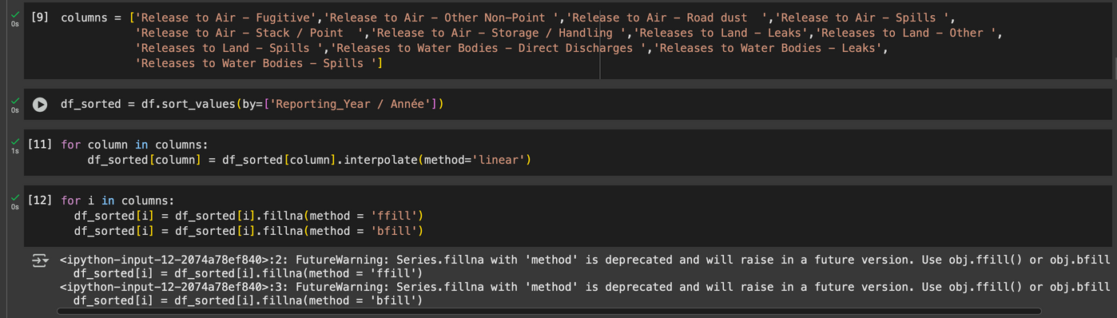
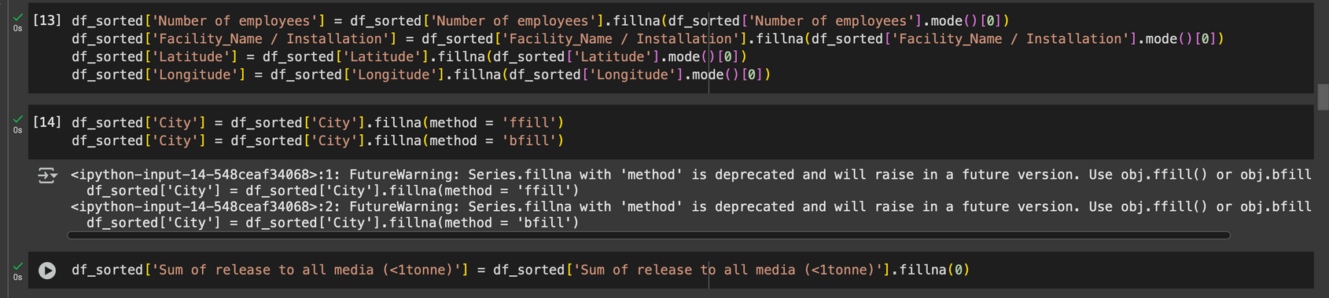
Handling Missing values
linear Interpolation
bfill / ffill
Mode imputation
fillna(0)

Slide 6
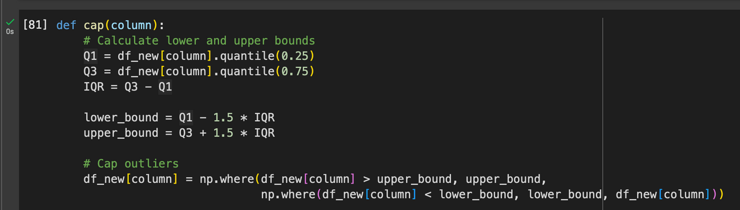
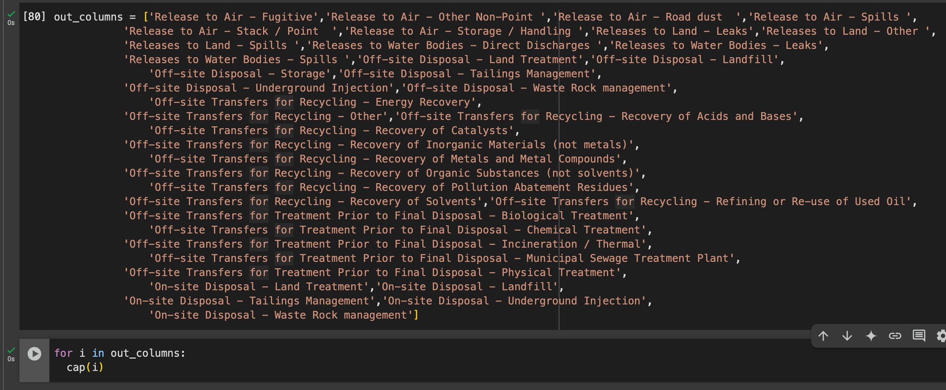
Handling Outliers
IQR (Inter Quartile Range) for outlier detection
Capping for handling outliers

Slide 7
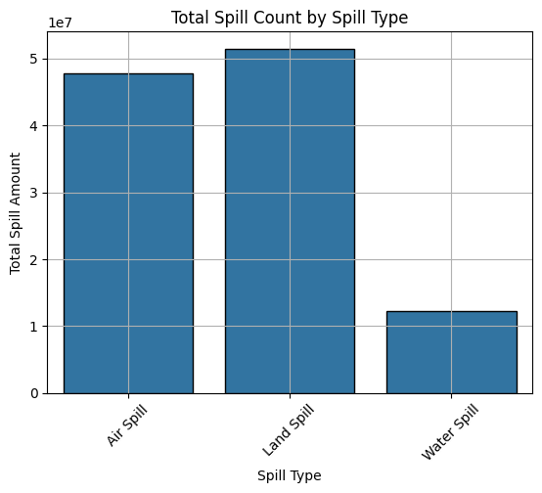
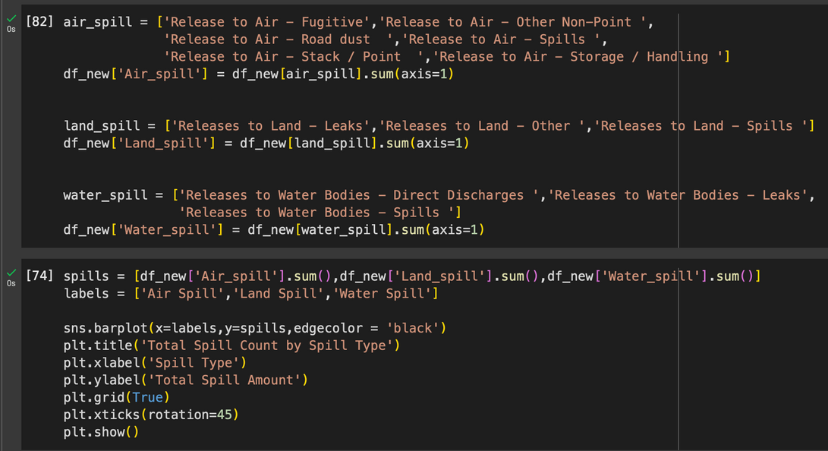
Spill type total count

Slide 8
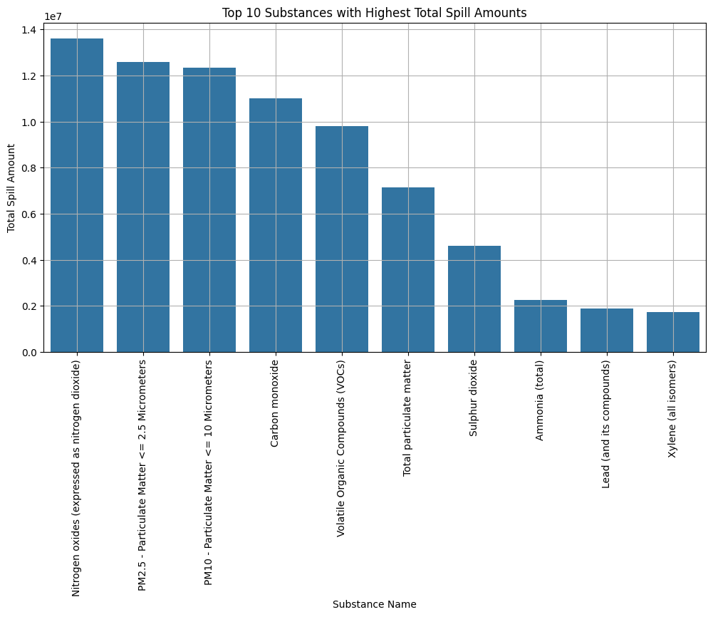
Top 10 substances
Nitrogen oxides (expressed as nitrogen dioxide)
PM2.5 - Particulate Matter <= 2.5 Micrometers
PM10 - Particulate Matter <= 10 Micrometers
Carbon monoxide
Volatile Organic Compounds (VOCs)
Total particulate matter
Sulphur dioxide
Ammonia (total)
Lead (and its compounds)
Xylene (all isomers)

Slide 9
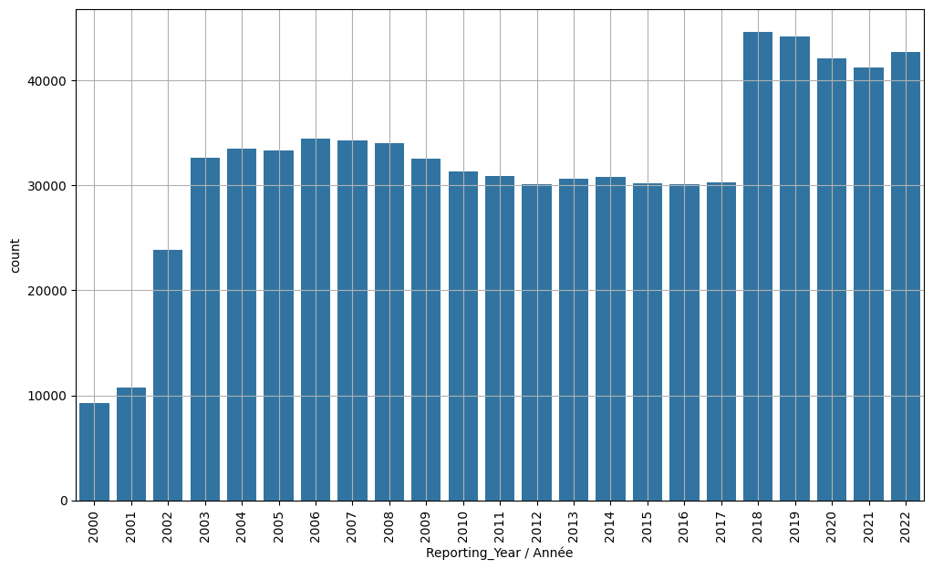
Spill Count by Reporting Year

Slide 10
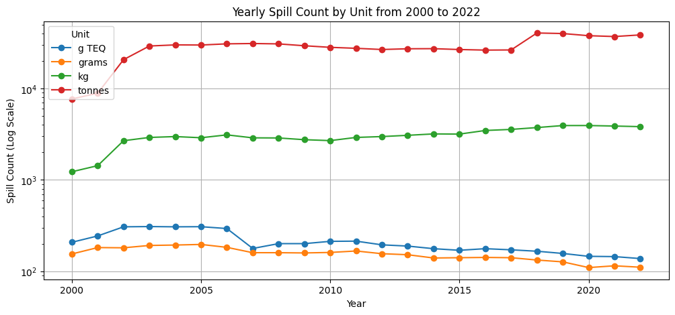
Total Spill Count by Unit Over years
g TEQ - grams of Toxic equivalency

Slide 11
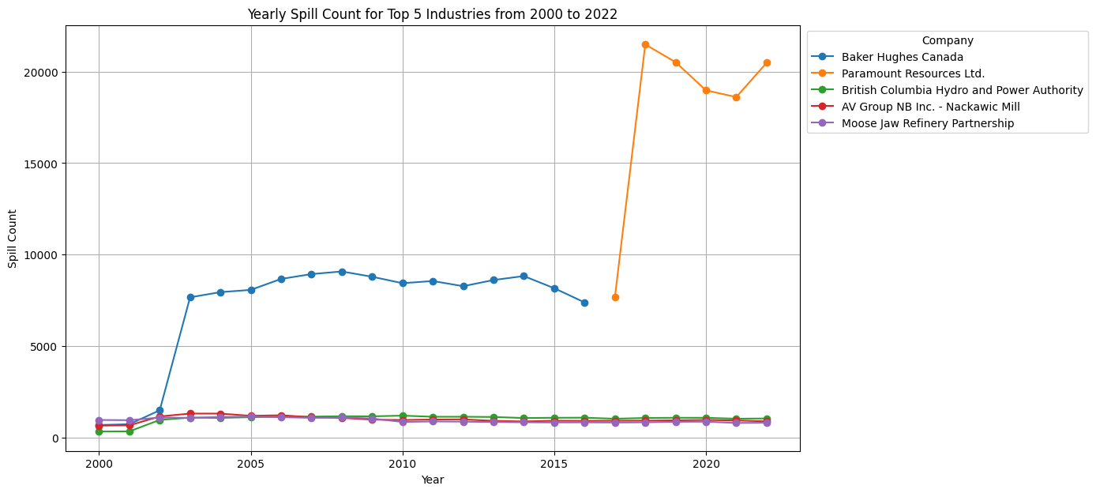
Top 5 industries with maximum spill count

Slide 12
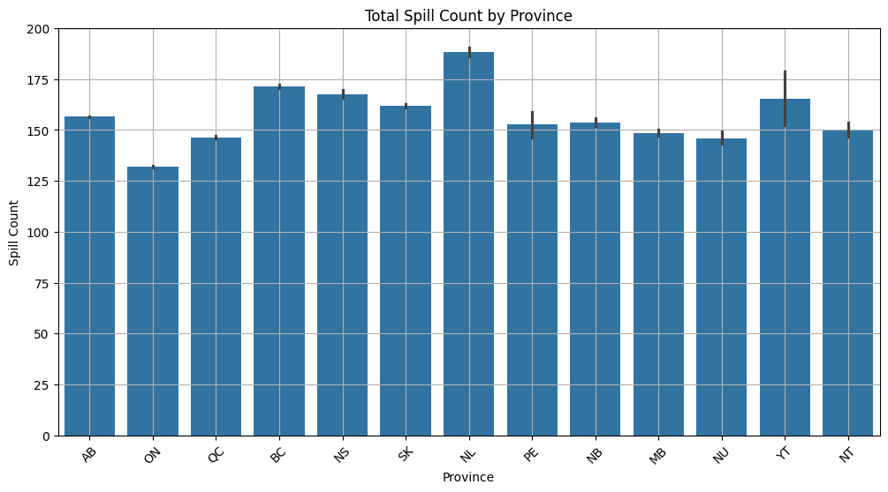
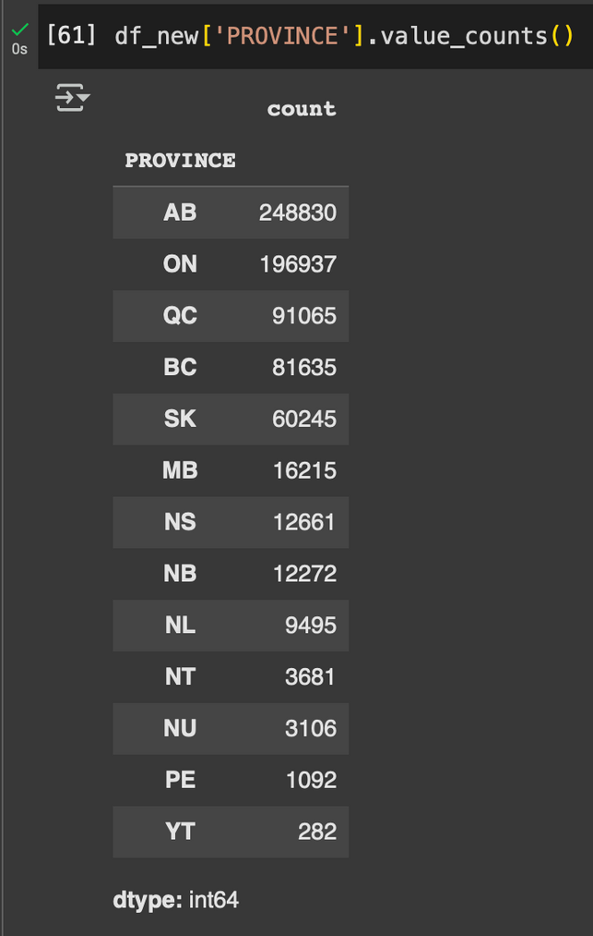
Province with maximum spill
Although count of AB is more, still releases is
maximum in NL

Slide 13
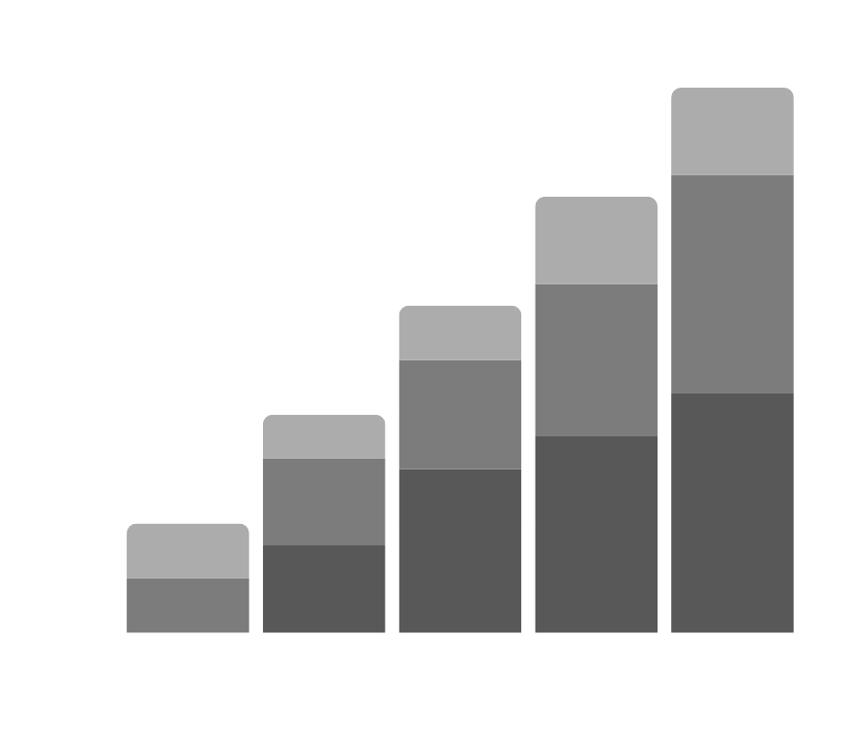
Thankyou

